Slide 1
TrawlExpert
A Tool for Environmental Scientific Research
Chris Schankula

Slide 2
Declining Fish Populations
Source: Great Lakes Fishery Commission, http://www.glfc.org/eforum/article7.html

Slide 3
Trawl Surveys
Used to estimate relative fish population, births, deaths, etc. over time
USGS dataset contains over 283,000 records from 1958-2016

Slide 4
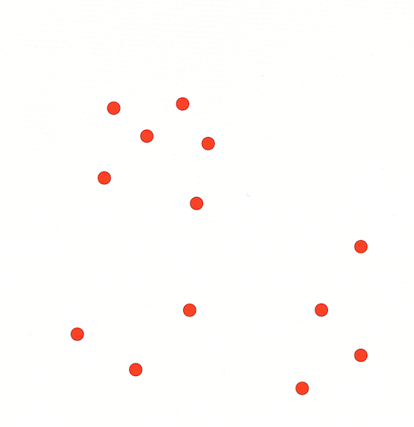
TrawlExpert
Domain-specific tools for extracting and classifying relevant data
Researcher can focus attention on analysis

Slide 5
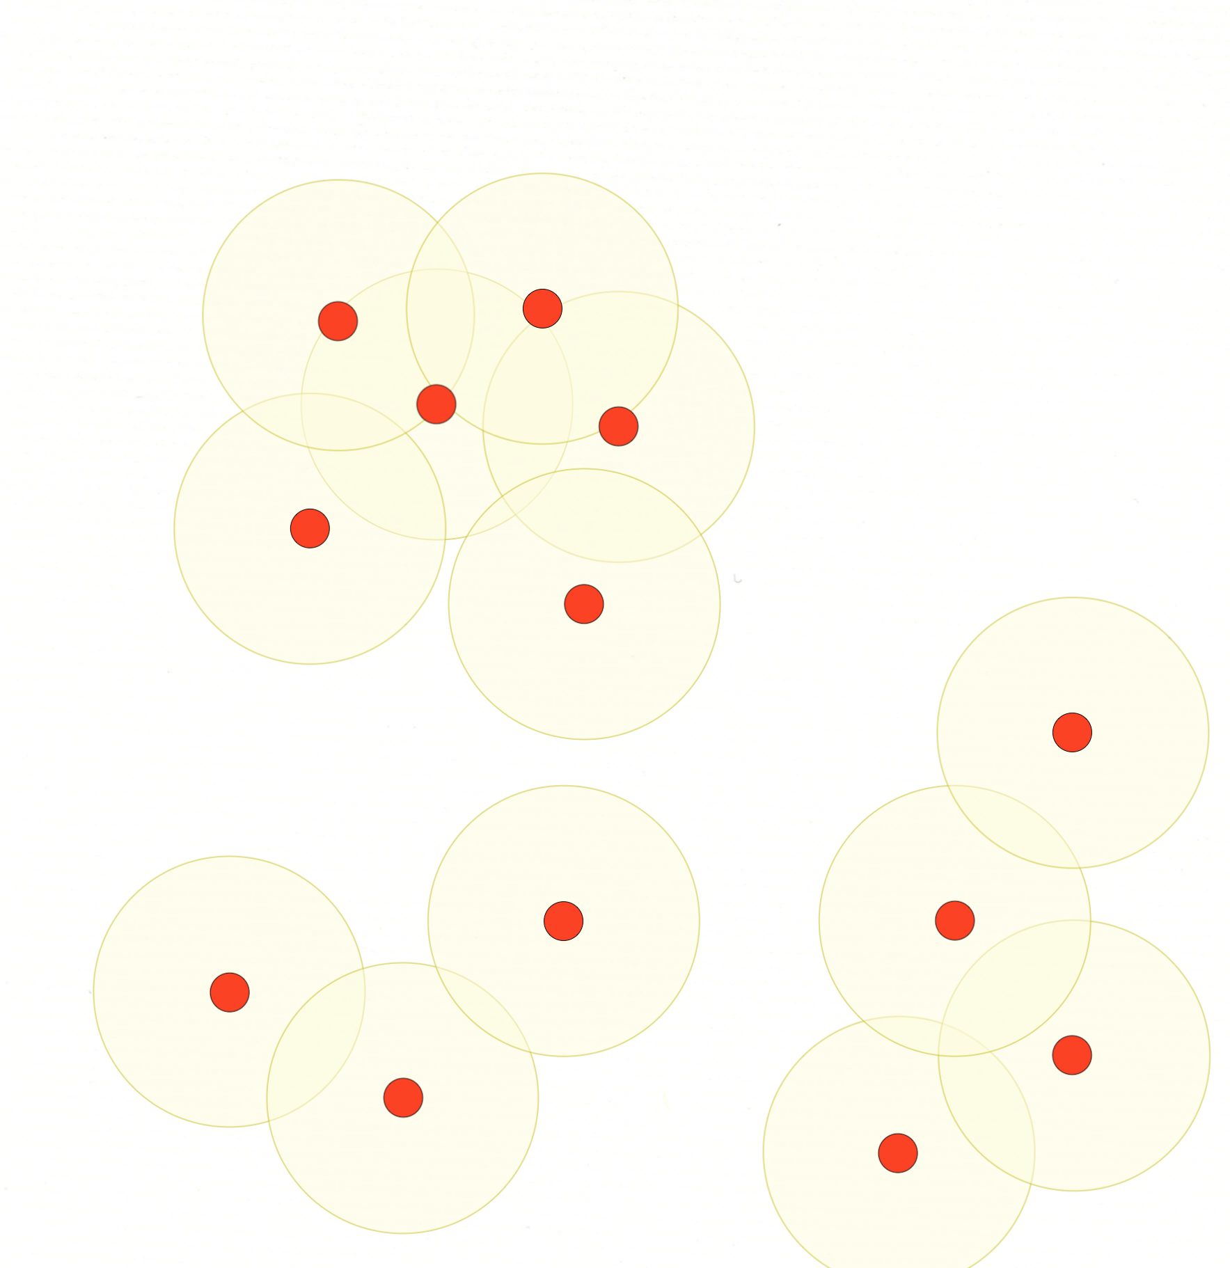
TrawlExpert
Domain-specific tools for extracting and classifying relevant data
Researcher can focus attention on analysis

Slide 6
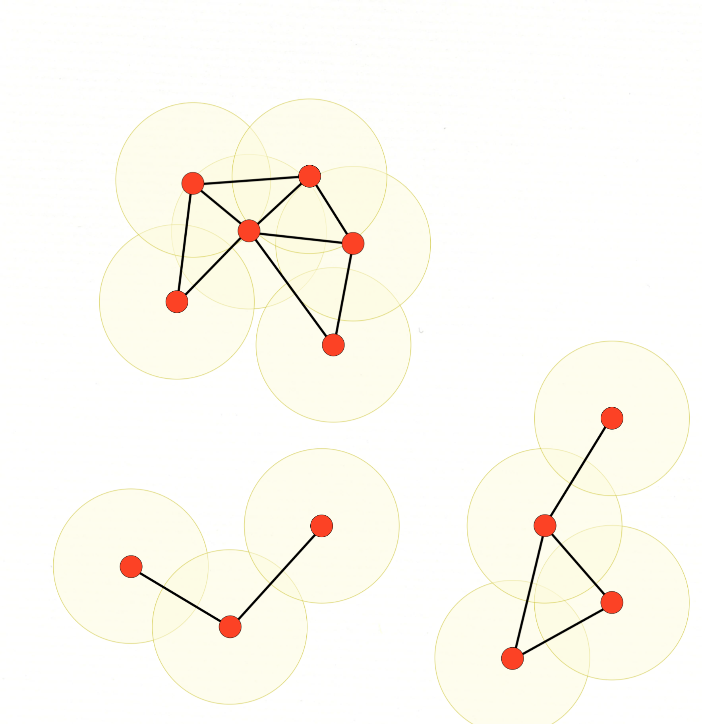
TrawlExpert
Domain-specific tools for extracting and classifying relevant data
Researcher can focus attention on analysis

Slide 7
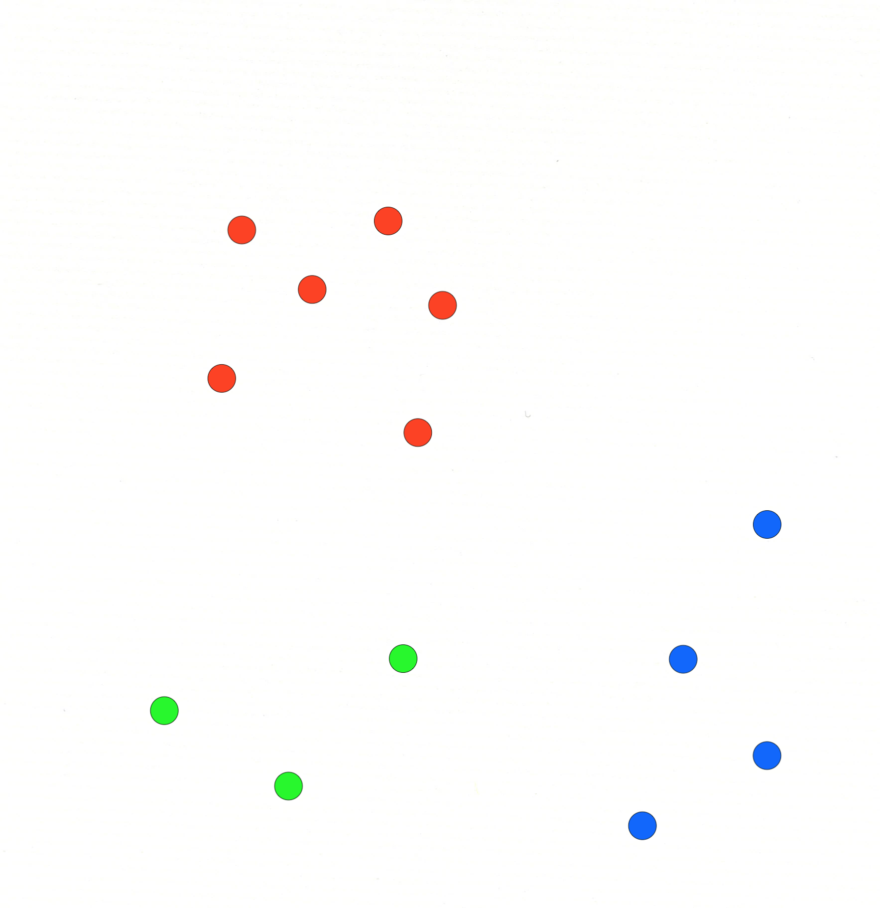
TrawlExpert
Domain-specific tools for extracting and classifying relevant data
Researcher can focus attention on analysis

Slide 8
Chris Schankula
TrawlExpert
This was an interesting project and if it was one
of the projects in my team, I would have liked
to implement it.
A. Strongly Disagree
B. Disagree
C. Neither agree nor Disagree
D. Agree
E. Strongly Agree

